Slide 1
RISC PIPELINE PROCESSOR DESIGN
Start Now

Slide 2
Table of Contents
01
Introduction
02
Design
03
A-Format
04
B-Format
05
L-Format
06
Conclusion
Processor Datapath & Controller
Processor Design Parameters
Arithmetic Instruction Format
Branch Instruction Format
Load-Store Instruction Format
Summary of design

Slide 3
01
Introduction
Back
Next

Slide 4
Introduction
Datapath for different instruction formats
A Format
B Format
L Format
Controller and its execution for different datapath
Back
Next

Slide 5
02
Design
Parameters
Back
Next

Slide 6
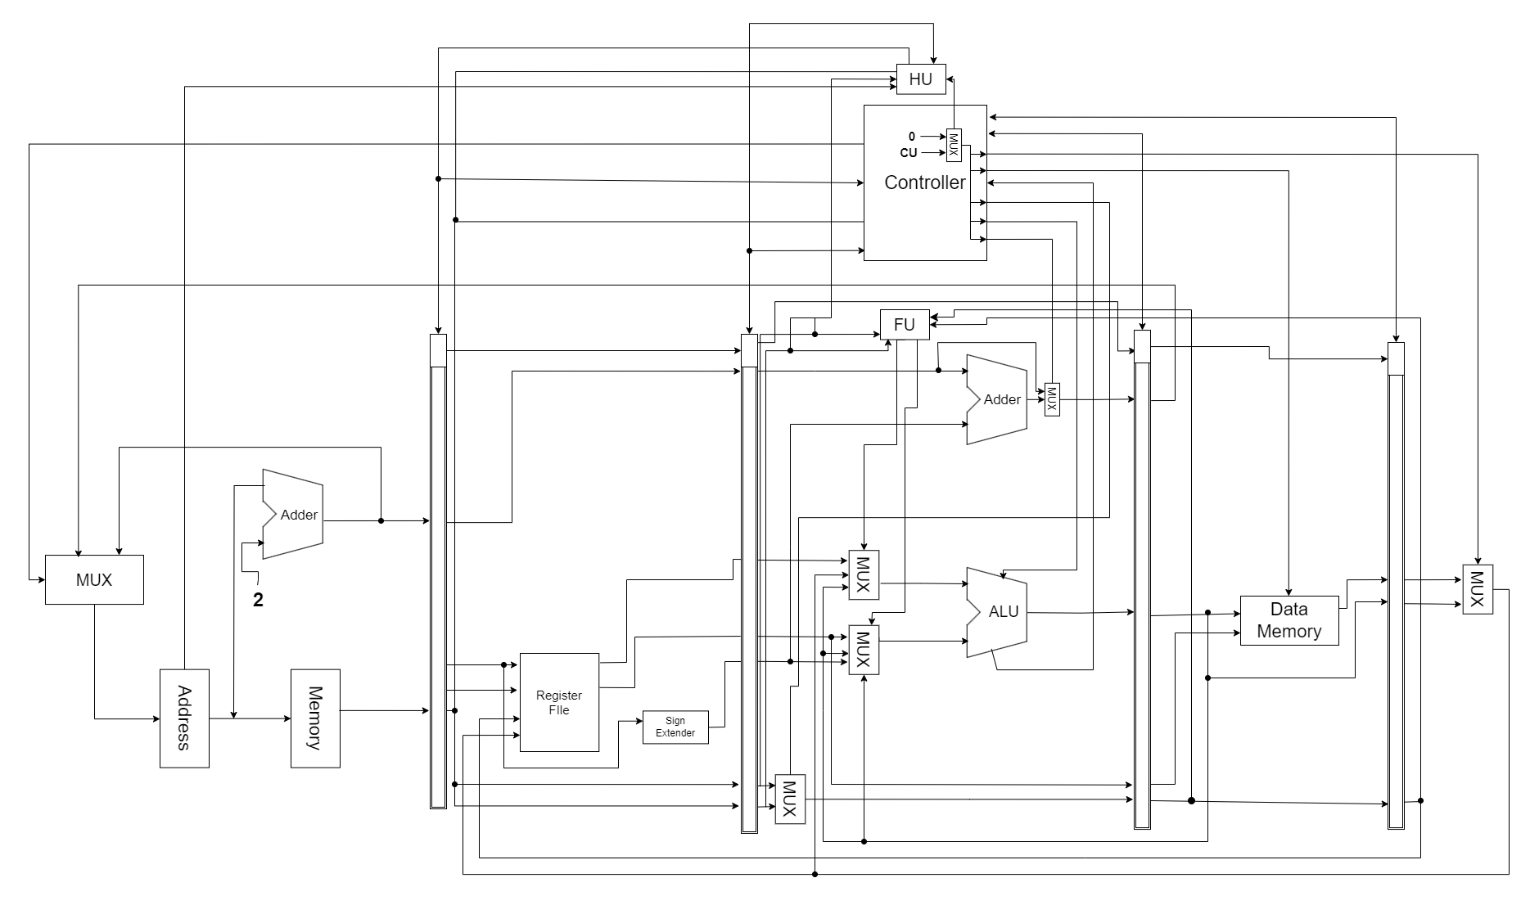
Design
Back
Next

Slide 7
Given Memory and ISA details
4-1 byte Registers in addition with a Link register
Instruction memory and Data memory of 256 bits
Length of Instructions is 2 bytes
Arithmetic format has implicit function
Additional Z and N flags for the ALU
2 byte Program counter
Back
Next

Slide 8
03
A-Format
Back
Next

Slide 9
Instruction Format
7
4
3
2
1
0
Op-code | Ra | Rb
unused
Back
Next

Slide 10
Arithmetic Function datapath
Input
Back
Next

Slide 11
04
B-Format
Back
Next

Slide 12
Instruction Format
7
4
3
2
0
Op-code | brx | –
ea (Destination address)
Back
Next

Slide 13
Branch Function datapath
Input
Back
Next

Slide 14
05
L-Format
Back
Next

Slide 15
Instruction Format
7
4
3
2
1
0
Op-code | Ra | –
ea (Destination address) / immediate
Back
Next

Slide 16
Load Function datapath
Input
Back
Next

Slide 17
Store Function datapath
Input
Back
Next

Slide 18
Thank you
Do you have any questions?
Submitted by
Milin Modi (1190172)
Priyam Sheth (1233198)

